Slide 1
Minimum Spanning Tree

Slide 2
General Problem: Spanning a Graph
A simple problem: Given a connected graph G=(V,E), find a minimal subset of the edges such that the graph is still connected
A graph G₂=(V,E2) such that G₂ is connected and removing any edge from E₂ makes G₂ disconnected
Example

Slide 3
Observations
Any solution to this problem is a tree
  Recall a tree does not need a root; just means acyclic
  For any cycle, could remove an edge and still be connected
  We usually just call the solutions spanning trees
Solution not unique unless original graph was already a tree
Problem ill-defined if original graph not connected
  We can find a spanning tree per connected component of the graph
  This is often called a spanning forest
A tree with |V| nodes has |V|-1 edges
  This every spanning tree solution has |V|-1 edges

Slide 4
Motivation
A spanning tree connects all the nodes with as few edges as possible
In most compelling uses, we have a weighted undirected graph and want a tree of least total cost
Minimize electrical wiring for a house or wires on a chip
Minimize road network
This is the minimum spanning tree problem
Two Approaches to find minimum spanning tree using Greedy
Prim’s Algorithm
Kruskal’s Algorithm

Slide 5
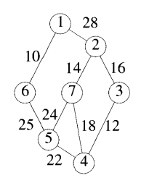
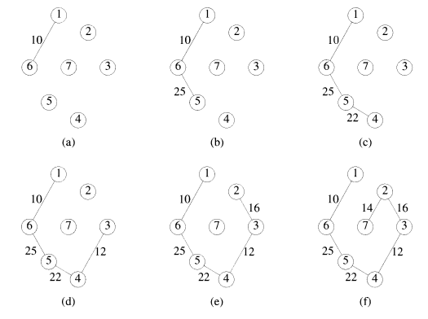
Prim’s Algorithm

Slide 6
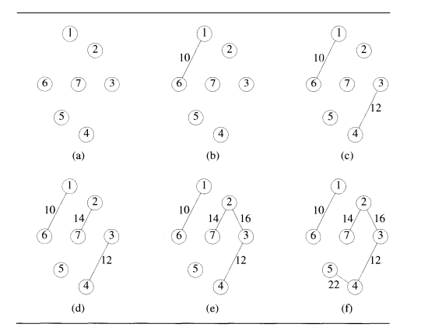
Kruskal’s Algorithm

Slide 7
